Slide 1
Five stage 32-bit pipelined MIPS CPU Design using System Verilog
Team 8
Hemanth Bolade
kiran Kamble
Abdul Hameed Shaik
Nikitha Bannurkar

Slide 2
1. Description 2. Source 3. Block diagram 4. Block Explanation 5. Team Contribution
Contents

Slide 3
Description
5 stage 32-bit microprocessor which can perform load, store and Arithmetic instructions. Using a pipelined type of approach to perform individual operations from one instruction to the next and executing it one after the other. We are designing a pipelined datapath which for 5 cycles and is different from the “Computer Organization and Design” (Davis A. Patterson and John L. Hennessy) 4 th edition diagram

Slide 4
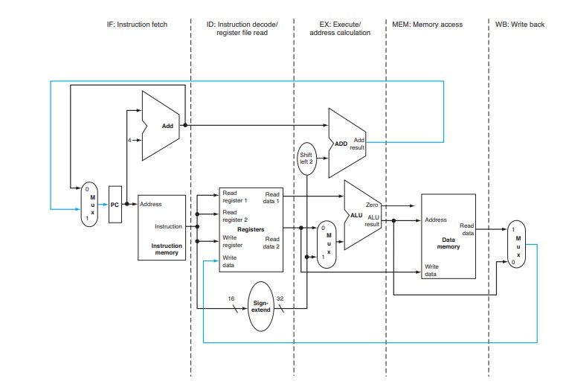
44.333
Source
Github Link : https://github.com/neelkshah/MIPS-Processor
Computer Organization and Design” (Davis A. Patterson and John L. Hennessy) 4 th edition diagram
4.33: The single cycle datapath. The data path created should support the instruction set. Implementing 32 bit MIPS design architecture

Slide 5
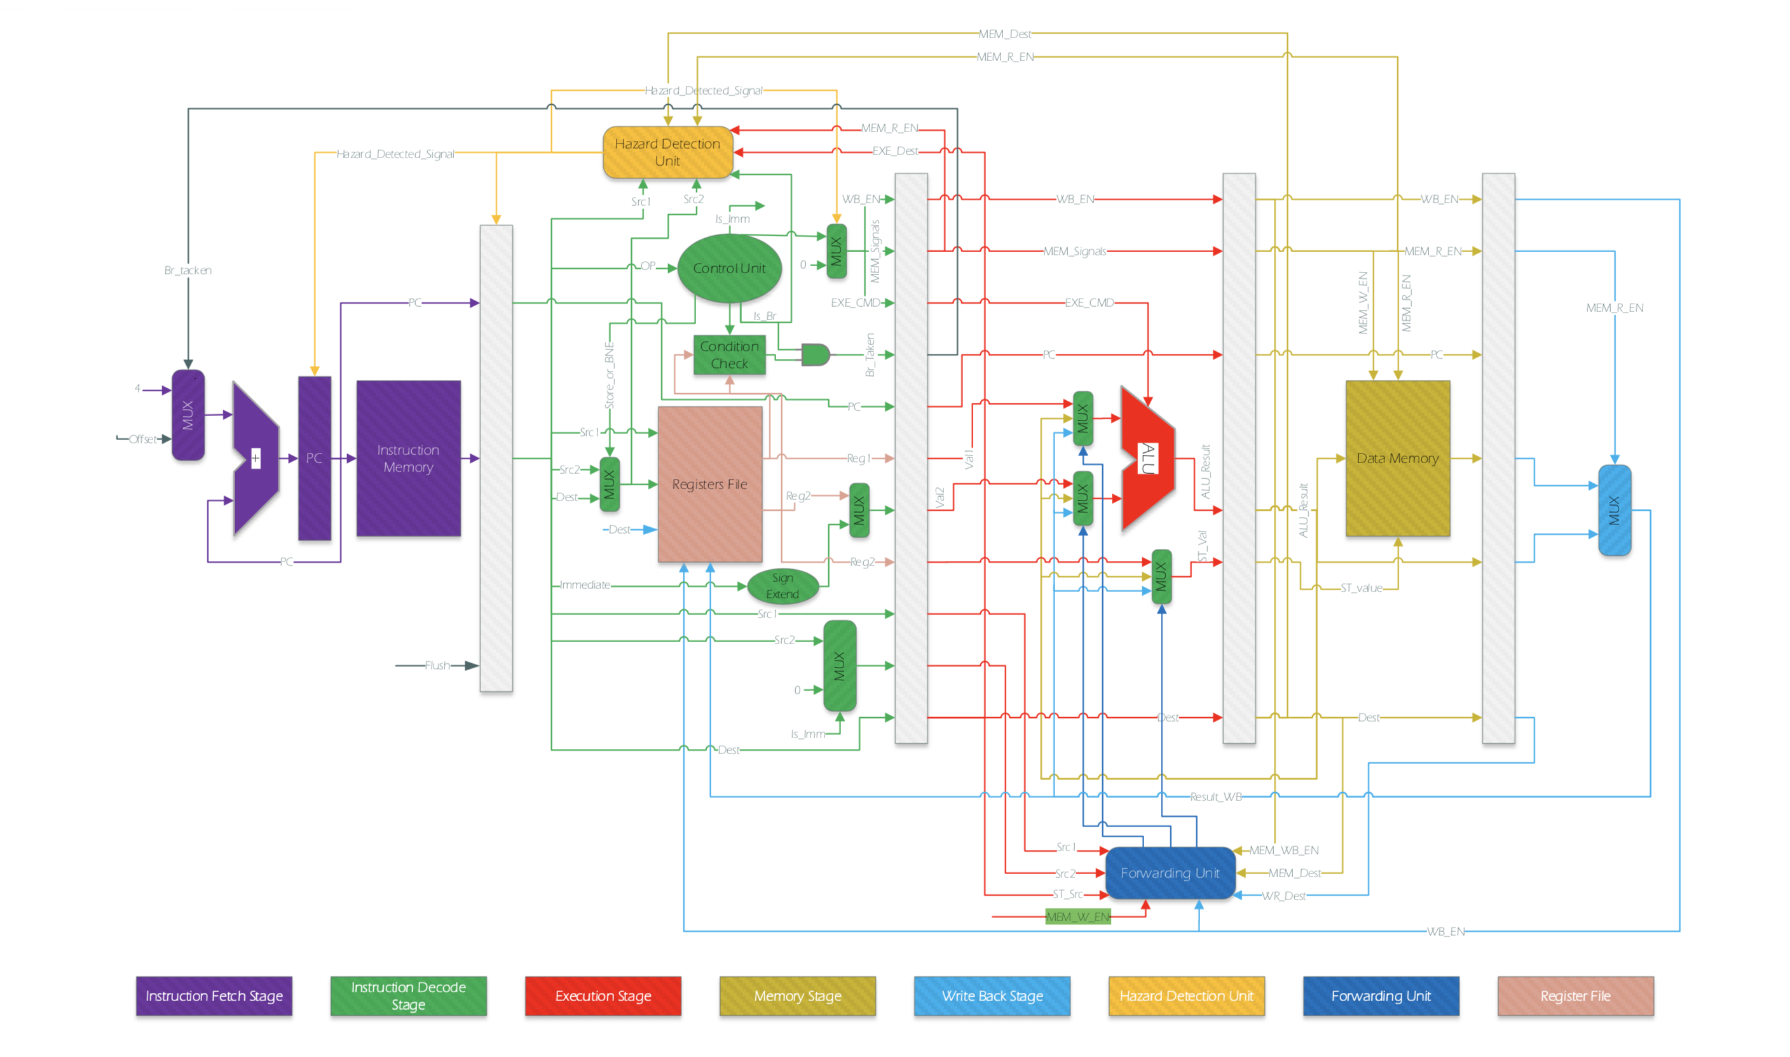
Block Diagram :5 Stage pipelined MIPS

Slide 6
5 stages:
1) Instruction Fetch
2) Instruction Decoder/ Register file reader
3) Execute
4) Memory access
5) Write back

Slide 7
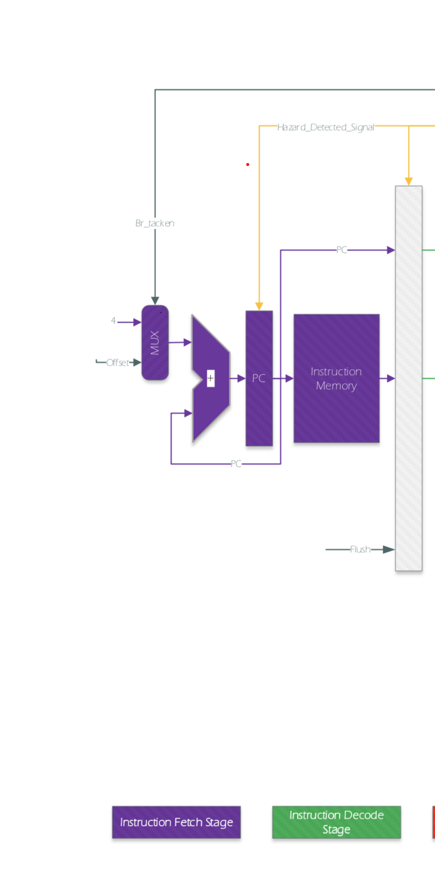
Instruction Fetch:
The instruction being read from memory using the address in the PC and then being placed in the IF/ID pipeline register.
The PC address is incremented by 4 and then written back into the PC to be ready foe next clock cycle.
The incremented address is also saved in the IF/ID pipeline register in case it is needed later for instruction .

Slide 8
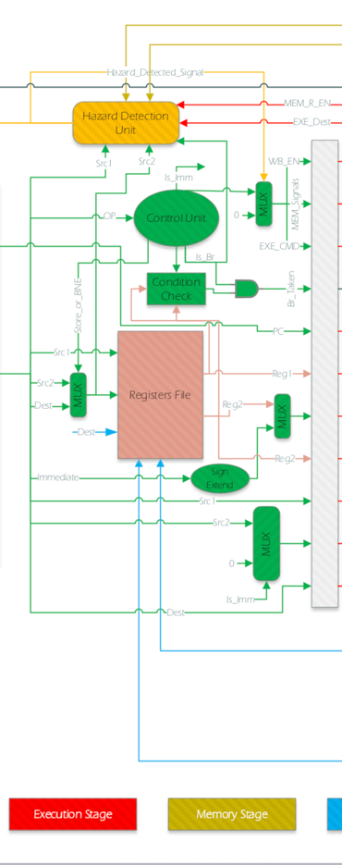
Instruction decode / register file read :
Here, the instruction portion of the IF/ID pipeline register supplying the 16 –bit immediate field, which is sign- extended to 32 bits, and the register numbers to read the two registers. All three values are stored in the ID/EX pipelined register, along with the incremented PC address.

Slide 9
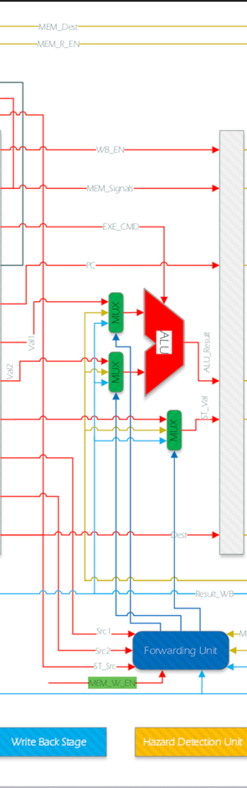
Execute :
The load instruction reads the contents of register and sign extended immediate from the ID/EX pipeline register and adds them using ALU. The sum is placed in EX/MEM pipeline register.

Slide 10
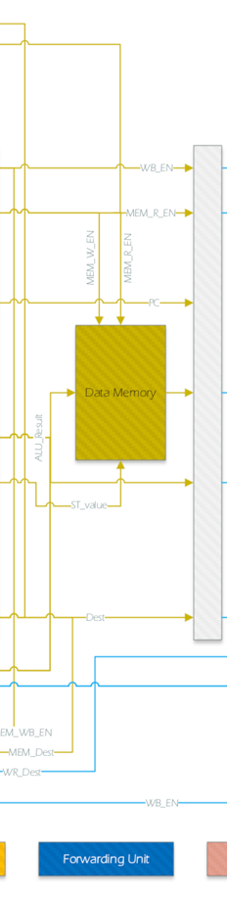
Memory access
The load instruction reading the data memory using the address from the EX/MEM pipeline register and loading the data into the MEM/WB pipeline register.

Slide 11
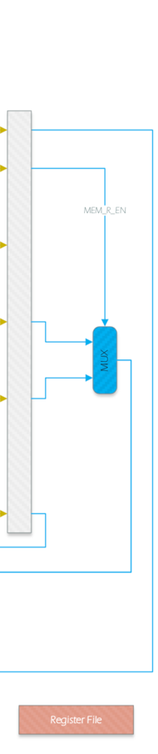
Write Back :
Reading the data from the MEM/WB pipeline register and writing it into the register file .

Slide 12
Team’s contribution
As a team, we worked together till the completion of the whole project. Individual Contribution are :
Name : Hemanth Bolade
Worked on instruction fetch and memory access modules.
Worked on testbench.
Name : Kiran Kamble
Worked on decoding stage and decoding the test bench.
Worked on passing the next instruction to the instruction decoder by passing the value.
Name : Abdul Hameed Shaik
Worked on reading trace file into memory and instruction fetch modules.
Worked on Hazard module.
Name : Nikitha Bannurkar
Worked on write backstage module.
Worked on decoding each cycle of the pipelining stage.

Slide 13
END

